Slide 1


Regression Challenge: Parametric and Non-Parametric Linear Regression and Knn
MASTER IN MEDICAL IMAGING AND APPLICATIONS
UNIVERSITY OF CASSINO
Statistical Learning and Data Mining
Carmen Guadalupe Colin Tenorio
Prof. Mario Rosario Guarracino
May 2023

Slide 2
Data
Numerical values
No missing values, Outliners
Need to scale features and Responses: equal contribution scale()
9 predictors

Slide 3
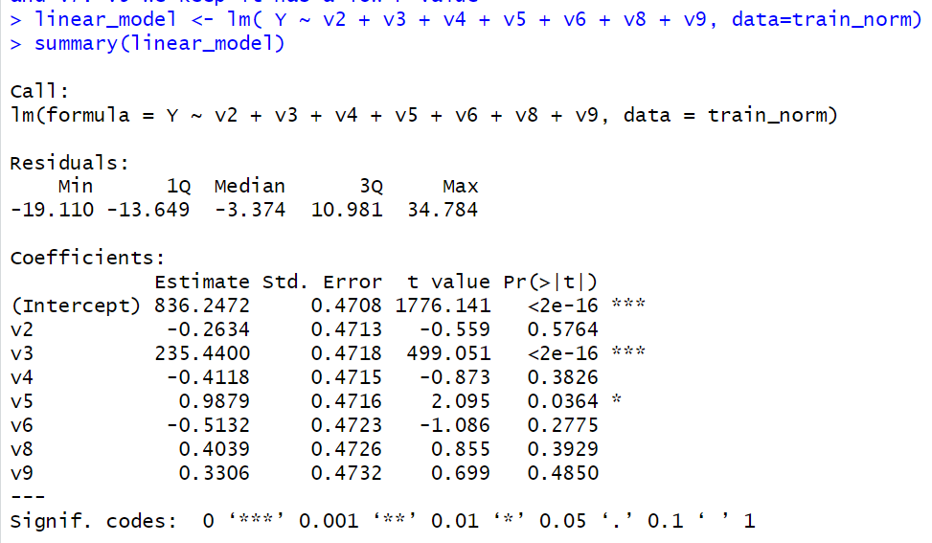
Linear Regression
Fit the model with all predictors
Find high correlated predictors: V1, V5, V7
Find non-linearity predictors
Find predictors with non-significant
P-value
Non-significant P-value and no linearity:
V2, V4, V6, V8 and V9

Slide 4
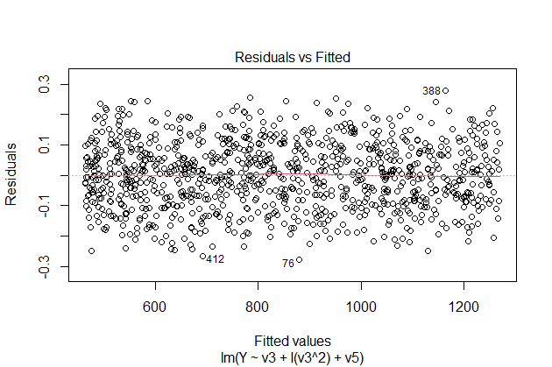
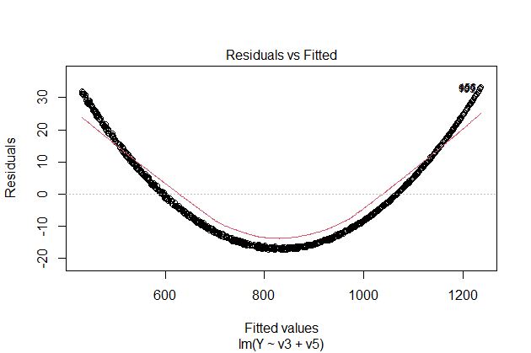
Linear Regression
V3 + V5
V3^2 + V5

Slide 5
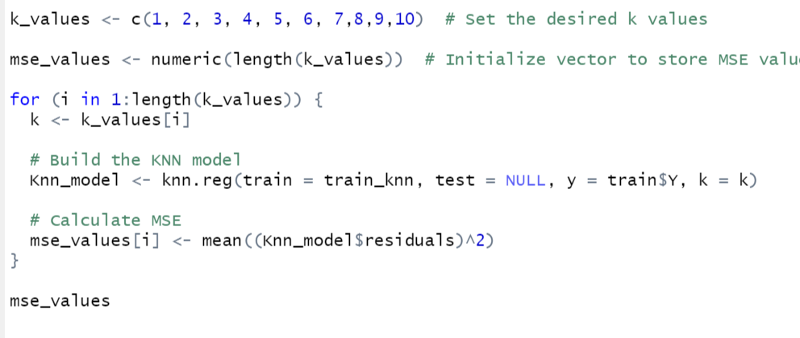
KNN
Use same predictors as in Linear regression
Best Predictor and more significant: V3
Try different values for K, choose the best value: 5

Slide 6
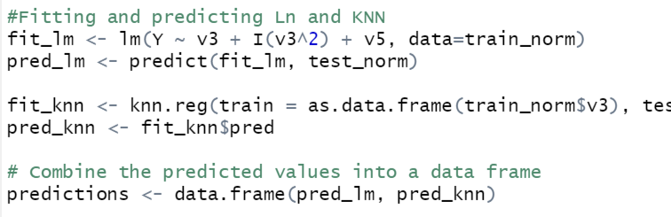
Test data
Same preprocessing as train data
Predictions with both approaches
pred_lm | pred_knn
808.320066 | 806.857942
468.054665 | 469.327165
1236.84255 | 1236.61221
540.208633 | 540.21557
1062.88663 | 1062.89947
536.551071 | 537.007913
738.052067 | 737.799591
564.240471 | 563.132035
972.706811 | 973.231809
1065.89395 | 1064.05659
1224.45834 | 1225.64966
468.092067 | 468.469893

Slide 7
¡Thank You!

